Slide 1
Company Bankruptcy Prediction NTU SC1015 Mini Project
By:Krishnadas Manoj, Cao Xing Ping, Keong Wee Kiat Edwin

Slide 2
Table of Content
Overview
Objectives
Data Sets
Model Selection and Evaluation
Results
Conclusion
References

Slide 3

Overview
Bankruptcy affects the finances of all stakeholders.
The project uses machine learning models to predict bankruptcy using financial data.
Our Aim: By predicting the likelihood of bankruptcy, companies can take proactive measures to improve their financial health and avoid potential financial distress

Slide 4
Objective
Understand the dataset and its features
Pre-process the data and standardize the financial ratios
Implement and evaluate different binary classification models
Compare the performance of the different models
Determine which model performs the best in predicting
Explore potential areas for future improvements

Slide 5
Data Preparation / Cleaning
Source – Company Bankruptcy Prediction (Kaggle)
Huge Dataset with a lot of information
Poses a challenge to analyze the data which results in slower performance and longer processing time
To identify critical predictors that are essential in determining the result
For example (Removal of outliers and using Confusion Matrix)

Slide 6
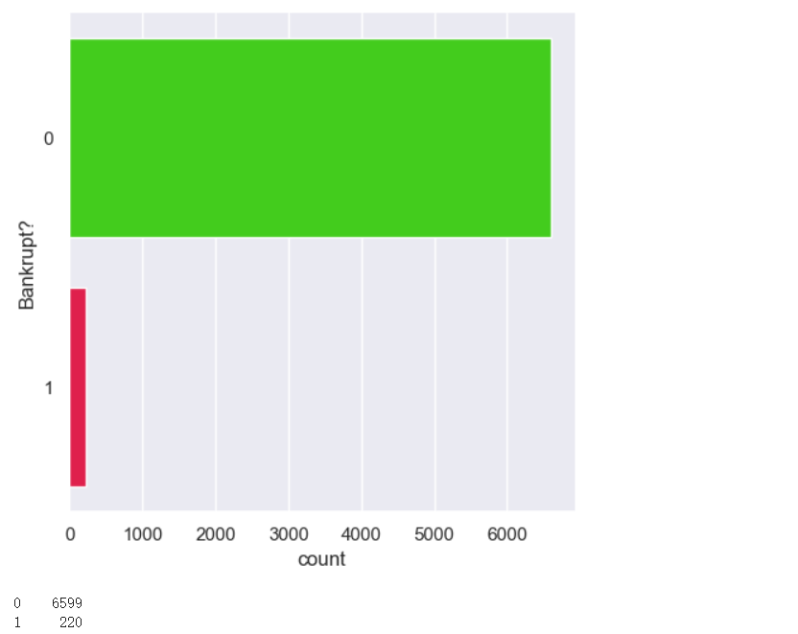
Data Exploration
Highly imbalanced, may affect the performance of ML model prediction
Show distribution of bankrupt and non-bankrupt companies

Slide 7
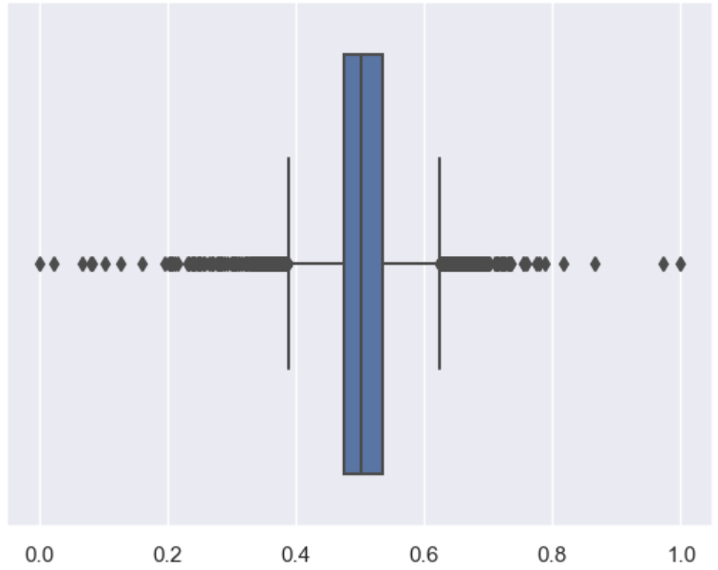
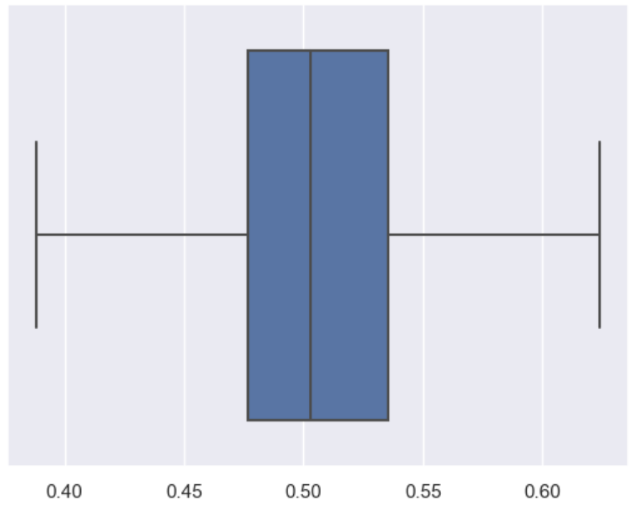
Outliers(Box Plot)
The Logistic Regression model achieved a decent accuracy of 95.41% in predicting bankruptcy status
Removing outliers led to an increase in accuracy and a decrease in the false-negative rate

Slide 8
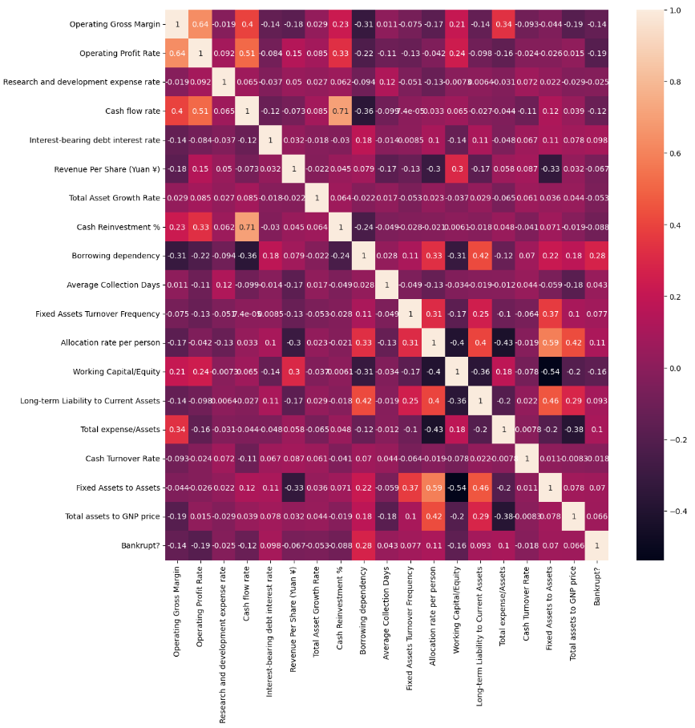
Correlation Matrix Heatmap
ROA(C) and operating gross margin have high correlation with bankruptcy status and may be good bankruptcy predictors.
Negative correlation exists between net income and current liability ratios with bankruptcy.

Slide 9
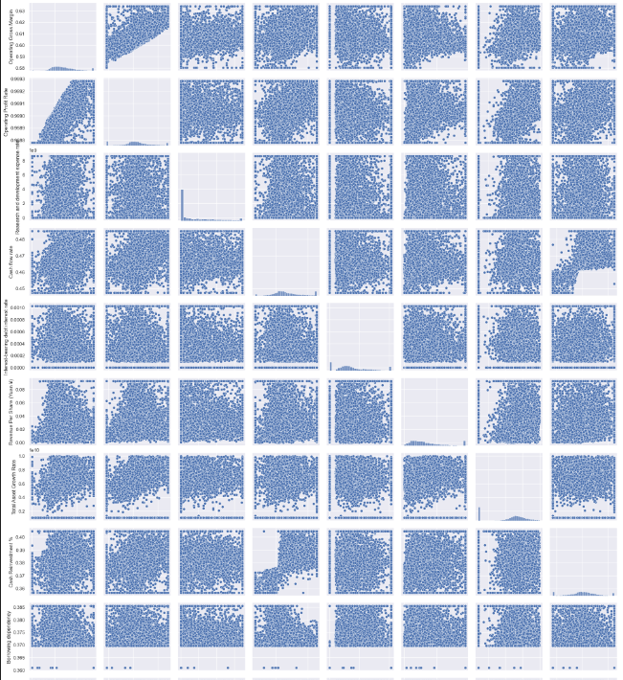
Feature Relationships
Most features do not separate bankrupt and non-bankrupt companies well
ROA(C) and cash flow to total assets may be good bankruptcy predictors
Current ratio and quick ratio may require non-linear models for their relationship with bankruptcy

Slide 10
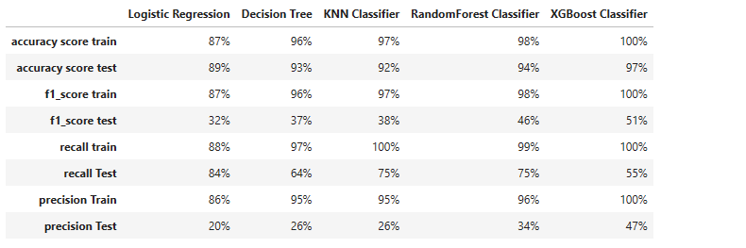
Model Evaluation
Evaluated models using precision, recall, and f1-score
XGBoost model performed the best overall

Slide 11
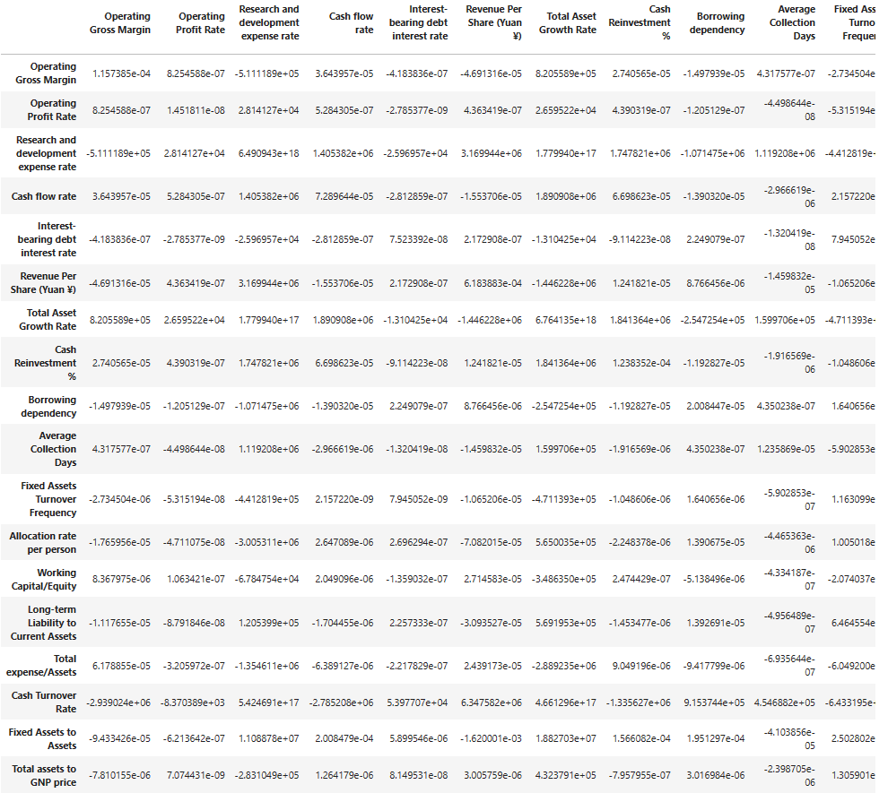
Feature Importance
It was calculated using the logistic regression model's coefficients, where larger absolute values indicate greater importance
Based on the regression model, there are 19 important predictors
Notes:
(Graph: Bar chart showing the importance of the top 10 features in predicting bankruptcy)

Slide 12

Limitations
Small Dataset
Imbalance Data- with only 4.4% of observations belonging to the bankrupt class
Time Horizon

Slide 13

Future Improvements
More advanced feature selection techniques
Hyperparameter tuning to optimize model performance
Trying different machine learning models or algorithms

Slide 14

Conclusion
Bankruptcy prediction shown accurate result with the model and feature
Useful for risk assessment in finance industry, investors and other stakeholders

Slide 15
Thank You!
CREDITS: This template was taken from Slidesgo, including the fonts

